Slide 1
Final Year Project Presentation & Demo
Incorporating Machine Learning in a Micro controller Driven Sensor System for Monitoring Cold Chain Pharmaceutical Products
Aaron Darcy L00179158

Slide 2
Overview & Motivation
Main motivation for the project is I am currently working for Kelsius a cold chain monitoring company based in Falcarragh.
Leveraging ML regression, this system unites sensors, a controller, and a web app to proactively forecast and signal shifts in pharmaceutical storage environments, facilitating timely alerts for preserving ideal conditions.

Slide 3
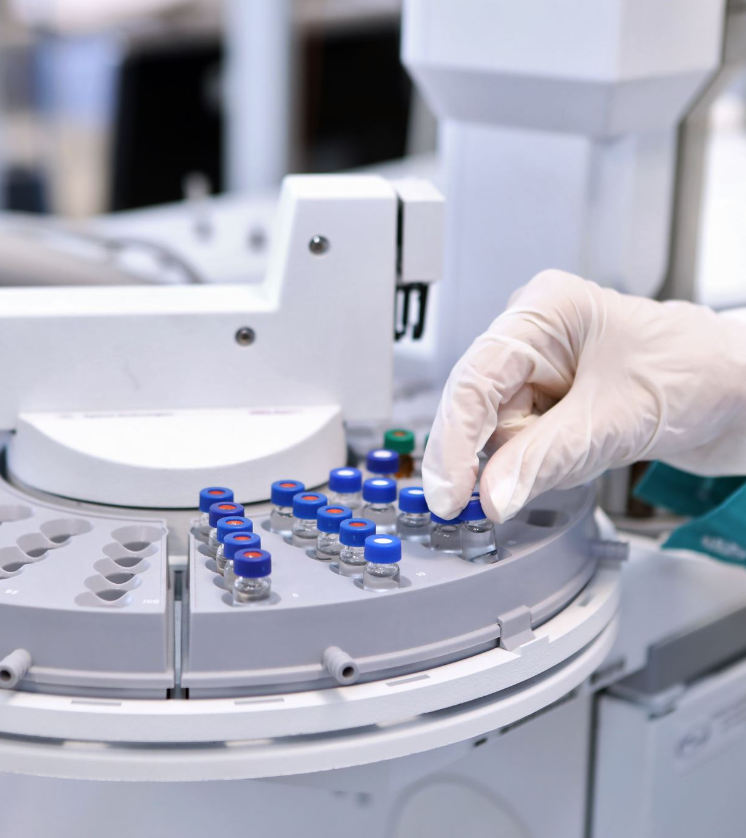
Comparison to Other Studies
No direct counterparts were found that mirror the hypothesis
While Kelsius, provide a similar product, they have not incorporated machine learning into their systems, highlighting the innovative aspect of this study.
Why?
Industry secrecy
Limited access to data
Competitive market advantage may deter sharing of innovative solutions

Slide 4
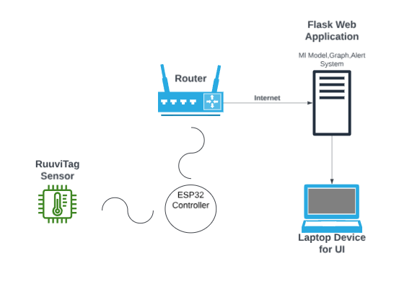
System Architecture

Slide 5
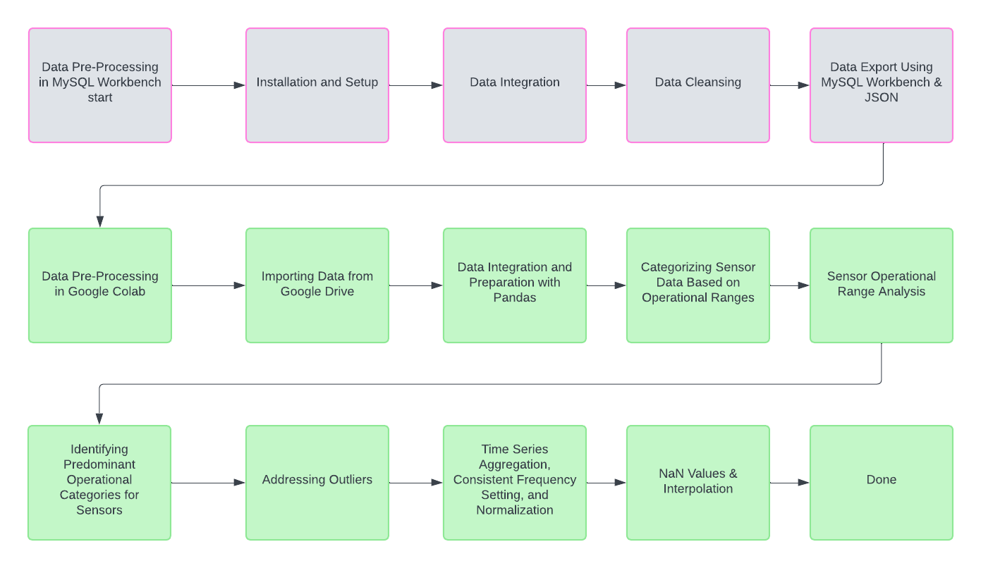
Data Pre - Processing

Slide 6
Justification of Development Environment & Languages
MySQL Workbench to facilitate Kelsius Sensor data that was delivered in the form of scripts.
Google Colab for easy access to powerful computing resources for machine learning & data manipulation.
Python due to its libraries and frameworks that facilitate efficient data manipulation and machine learning
Flask was employed to develop a web application due to its simplicity and flexibility, which aligns well with the overall system that is also built on Python.
Movoki & C++ used for programming the ESP32 microcontroller due to its ability to manage limited hardware resources effectively, ensuring optimal performance in embedded systems

Slide 7
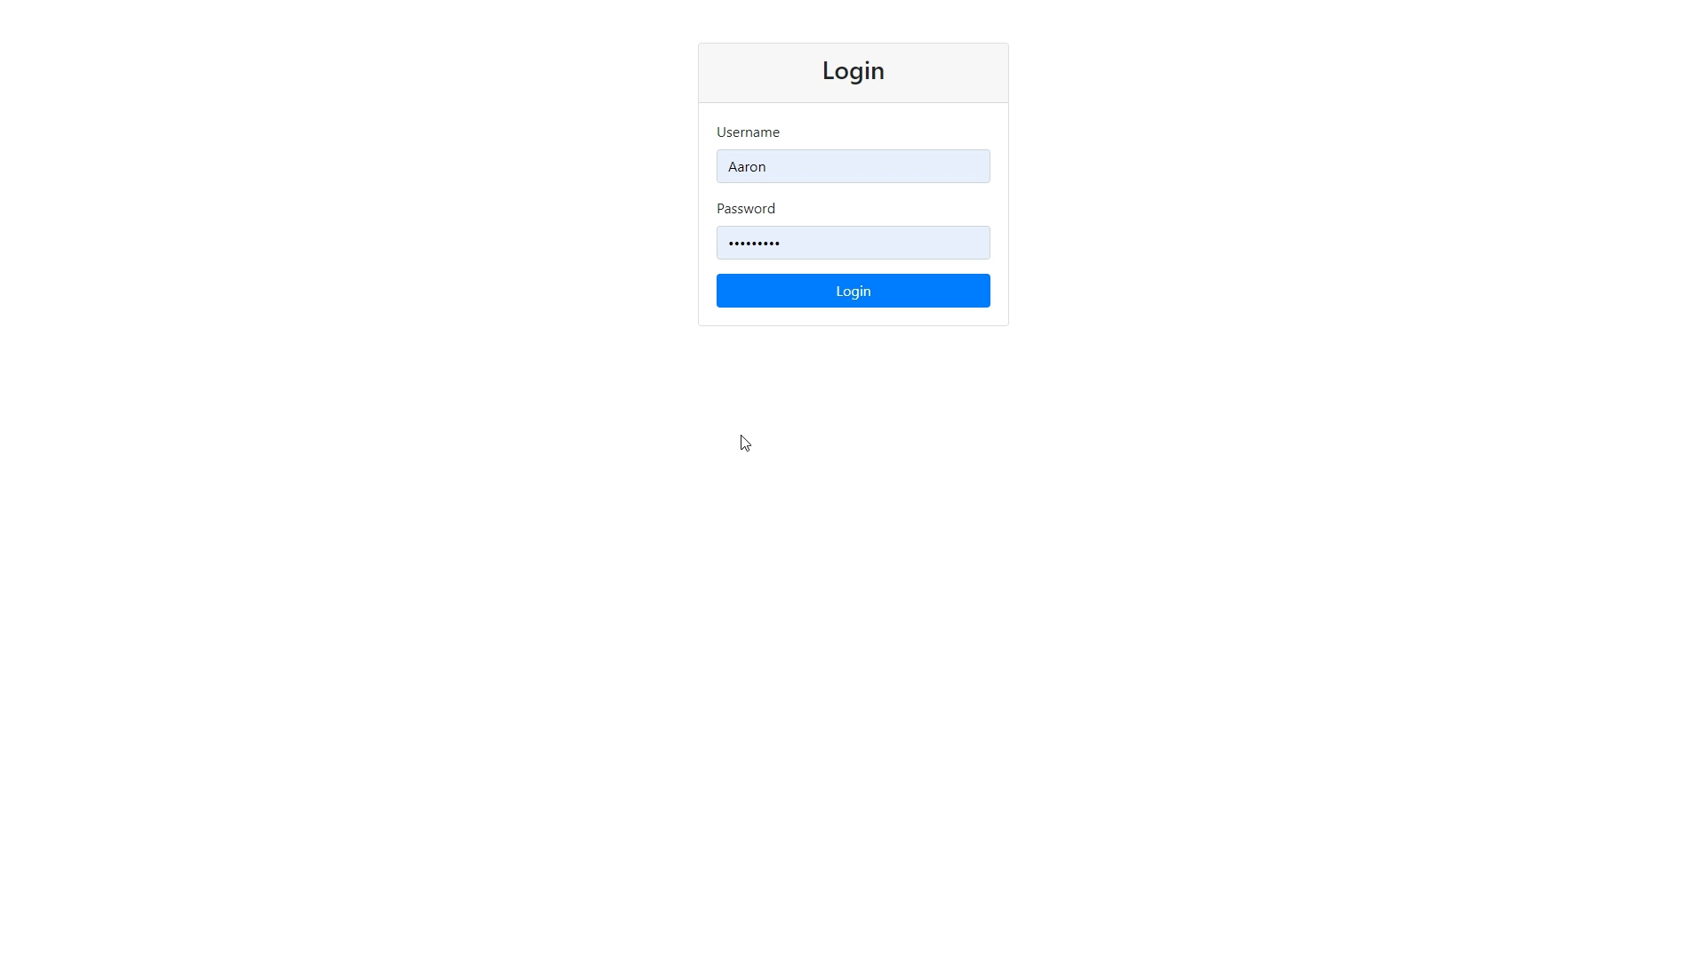
Implementation/Demo

Slide 8
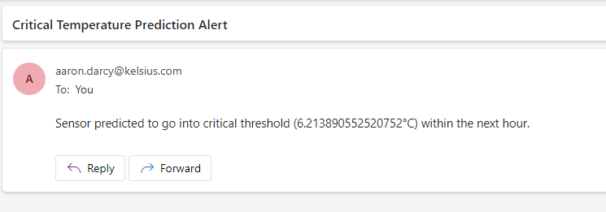
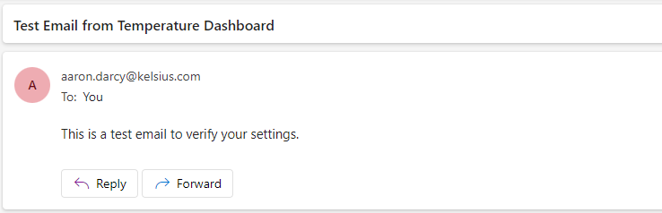
Implementation/Demo

Slide 9
Challenges / Limitations
Handling and preprocessing of large datasets for machine learning.
Using ARIMA for regression on extremely large datasets is not feasible.
Ensuring high accuracy on unseen data.
Computational resource constraints(Long training times & Cost).
Ensuring real-time performance with limited computing resources on the microcontroller.
Scope Creep & Time
A combination of all these challenges limited the final project to a model for regression in a single category instead of each category having its own dedicated model & anomaly detection

Slide 10
Results & Evaluation
Overall, a working system that alerts users when a temperature deviation is occurring or alerts the user when it predicts one to occur.
Achieved over 96% accuracy in predicting temperature records with LSTM models.
Improved proactivity in cold chain management for pharmaceutical products.
Real Time monitoring & alerts of cold chain pharmaceutical products.
Comparison with traditional systems shows enhanced predictability and accuracy.

Slide 11
How can this project be extended?
Anomaly Detection built upon the regression aspect.
Category Specific models (e.g Fridge, Freezer, Incubator, Cryogenic)
Development of a mobile app for more accessible real-time data and alerts.
Expansion into other industries with environmental monitoring
Refinement of Regression model.

